Slide 1
Smart Irrigation And Monitoring System
Guided By:- Presented By:-
Brijesh Vala Sir Ajay Chauhan - 150303105020
Darsh Patel - 150303105120
Devang Bhimani - 150303105015
Mritesh Adak - 150303105001

Slide 2
Motivation:-
Today water has become one of the most precious resource on the Earth and one of the most important factors in agriculture is water availability. Water availability is also a critical variable for virtually every other economic activity, including industry, the energy sector, and public use.
In recent years, water availability has become an issue. To schedule irrigation properly, a grower must know the environmental demand for surface water.
Knowledge of exact amount of water required by different crop in a given set of climatological condition of a region is great help in planning of irrigation scheme, irrigation scheduling, effective design and management of irrigation system. This is achieved by use of irrigation controllers.

Slide 3
Introduction:-
Agriculture is the art of science or exercise of farming, which play a vital role in the ecosystem. The survival and existence of the world is in the hands of the agriculture. It includes the cultivation of the soil for the growing of crops, vegetables and fruits.
So, we proposed one system that solve the problem of water and save farmers time which he spend for the water supplying to the crops.
We are making a system that supply water to the crops based on the moisture level of the soil. Different crops and soil need different amount of water. So, we set that threshold value in the device that is work based on values.

Slide 4
System Flow
This system will mainly comprise of two modules:
Arduino UNO microcontroller i.e. sensors, gsm module, relay module.
Embeded system i.e system programming.

Slide 5
Sr. No. | Title of the Project | Author(s) | Journal/Conference | Context
1 | Smart Irrigation Using Low-Cost Moisture Sensors | A. Kumar , K. Kamal , M. O. Arshad , S. Mathavan | IEEE 2014 Global Humanitarian Technology Conference | The low-cost and wireless nature of the sensing hardware presents the possibility to monitor the moisture levels of large agricultural fields.
2 | Low cost Remotely operated smart Irrigation system | Sangamesh Malge, Kalyani Bhole | 2015 International Conference on Industrial Instrumentation and Control (ICIC) | The free SMS facilities provided to farmers makes it more cost effective. This is also very easy for the farmers also.
3 | INTELLIGENT IRRIGATION SYSTEM – AN IOT BASED APPROACH | Dr.M. Newlin Rajkumar, S.Abinya, Dr.V.Venkatesa Kumar | IEEE International Conference on Innovations in Green Energy and Healthcare Technologies(ICIGEHT’17) | Automated control features with using microcontroller which turns the pumping motor ON and OFF on detecting the temperature, humidity, and soil moisture.
4 | IOT BASED SMART CROP-FIELD MONITORING AND AUTOMATION IRRIGATION SYSTEM | R. Nageswara Rao, B.Sridhar | International Conference on Inventive Systems and Control (ICISC 2018) | The proposed system developed on the information sent from the sensors and estimate the quantity of water needed.
5 | SISFAT: Smart Irrigation System with Flood Avoidance Technique | Vidya Sagar S, Ragav Kumar G, Lino X T Xavier | 2017 Third International Conference on Science Technology Engineering & Management (ICONSTEM) | Smart Irrigation System (SIS) by detecting the dampness content as it turns the engine ON/OFF automatically.

Slide 6
1. Title of the Journal paper: Low cost Remotely operated smart Irrigation system
Author(s) : Sangamesh Malge, Kalyani Bhole
Journal/Conference : 2015 International Conference on Industrial Instrumentation and Control (ICIC)
Volume : Issue: Year:2015
Methodology used:-
There is three steps of methodology:
Surface Irrigation
Surface irrigation is often referred to as flood irrigation. This is because the water distribution is uncontrolled. The technique involves application and distribution of water over the land surface by gravity.
It is a commonly used method of irrigation in many parts of the globe. But this method is highly inefficient as it can cause water logging, thereby delaying plant growth.
Sprinkler Irrigation
In this type, the water is piped to one or more locations in the field, and is distributed by overhead high pressure sprinklers or guns. This method is useful when the quantity of water available is less. It also involves lesser manual labor and water wastage.
Drip Irrigation
In drip irrigation, the water is allowed to drip slowly to the roots of the plants. This is done through a network of valves, pipes, tubing and emitters. The narrow tubes deliver water directly to the roots of the plants.
The water is soaked by the soil immediately before it evaporates. Also, the water is delivered to the plants only when required. This method is highly advantageous over the other methods as it helps in reducing water and fertilizer wastage by a great extent and also reduces manual work.
Conclusions drawn:-
Thus proposed and developed system accomplished irrigation process in a smart way. This system assures protection of motor against fluctuating power supply, dry dun state, overheating of motor winding. This system is very helpful to farmers whose irrigation pumps are placed far away from their home. Working of PIC18F4550 microcontroller as the water level detector sensor and rain detector sensor reduces the need for a separate sensors. Inbuilt ADC of the microcontroller also reduces need for a external hardware circuitry. So proposed system is very cost effective and enhances agriculture productivity.

Slide 7
Reference:-
[1] S. Padmanaban and A. Sarkar, “Electricity demand side management (dsm) in india,” in A Strategic and Policy Perspective.” Office of Energy, Environmental, and Enterprise, USAID/India, 2001.
[2] A. Suprem, N. Mahalik, and K. Kim, “A review on application of technology systems, standards and interfaces for agriculture and food sector,” Computer Standards & Interfaces, vol. 35, no. 4, pp. 355–364,
2013.
[3] Rasin, Zulhani, Hizzi Hamzah, and Mohd Shahrieel Mohd Aras, “Application and evaluation of high power ZigBee based wireless sensor network in water irrigation control monitoring system,” in Industrial
Electronics Applications, 2009. ISIEA 2009. IEEE Symposium on. Vol.
2. IEEE, 2009.
[4] Chao Long, Haiyan Liu, Ping Zhou, “System of Remote Irrigation Based on GPRS,” Information Technology Journal, vol:10, pp:1044-1049, 2011.
[5] M. Nesa Sudha , M.L. Valarmathi , Anni Susan Babu, “Energy efficient data transmission in automatic irrigation system using wireless sensor networks,” in Computers and Electronics in Agriculture. vol:78, pp:215-
221, 2011.

Slide 8
02.: Title of the Journal Paper: Smart Irrigation System Using Internet of Things
Author(s): Babanna Kumbar, Basavaraj Galagi, Bheemashankar and Naveen Honnalli
Journal: Bonfring International Journal of Research in Communication Engineering
Keywords-This paper describes the smart irrigation system using the concept of IOT. Improvise the agriculture process using embedded system
The system is monitored by server through internet which will be the key feature for message passing and information sharing.
Keywords: IOT, API- Application Programming Interface, IP, MQTT- Message Queue Telemetry Transport.
Physical connections:
1. The field includes two regions: 1,2 and a water reservoir.
2. Submerse the submersible motor pump in the reservoir.
3. Place the valve 1 in region 1
4. Place the valve 2 in region 2
Make proper pipe connections from water pump to the valves.
Extend the pipeline connection to respective fields for water supply.
Place water level indicator in the water reservoir.
Now, the soil moisture sensor reads the moisture status on the soil. If it does not match the predefined level then the water pump starts.
The whole system can be monitored remotely on other computer via mobile application.
The wifi module will be used to connect the system to internet to update data on remote device.
The message sent by My MQTT android app will sent received by the user who can control the motor pump and supply of water.
MQTT stands for Message Queue Telemetry Transport. Its function is to transfer message from machine to machine.

Slide 9
References
R.suresh1 , S.Gopinath2 , K.Govindaraju3 , T.Devika4 , N.SuthanthiraVanitha5 “GSM based Automated Irrigation Control using Raingun Irrigation System” International Journal of Advanced Research in Computer and Communication Engineering Vol. 3, Issue 2, February 2014
Review Paper based on automatic irrigation system IJAICT Volume 1, Issue 9, January 2015, Doi:01.0401/ijaict.2015.09.01 Published on 05 (02) 2015
Texas Instrument, LM35, SNIS159G –AUGUST 1999– REVISED AUGUST 2016
Light dependant resistor, electronics4u.
Arduino uno, Arduino.com/arduinounoboard
ITEAD studio electronicaestudio, istd016A.pdf

Slide 10
03.: Title of the Journal Paper: Arduino Based Smart Irrigation System using IOT
Author(s): R.Nandhini1, S.Poovizhi2, Priyanka Jose3, R.Ranjitha4, Dr.S.Anila
Journal:3rd National Conference on Intelligent Information and Computing Technologies.
Keywords-The main objective of this paper is to automate the irrigation system for 2 main purposes:
1. Water management.
2. Intruder Detection
This system will allow farmers to have access to servers about the field conditions, thus reducing man power.
Agriculture uses 85% fresh water available and this ratio increases as the demand of food grains increases.
Due to this efficient water management has become a major concern that needs to be resolved
The following are the components used for the connection:
Soil moisture sensor: It will detect the moisture level of the soil terms of percentage and update its value to the system.
pH sensor: It detects the nature of the soil
If pH<7 then acidic nature.
If pH>7 then basic nature.
Pressure sensor: It detects the pressure of atmosphere for weather forecasting.
PIR sensor: Passive Infrared sensor which detects the motion with variation in infrared radiation.
GSM module: Communication of the device via text message and SMS commands.
All these sensors are connected to Arduino Uno and embedded system to fulfill its functionality.
The readings from sensors are sent to the remote device so that the user can monitor the condition of the fields..
The PIR sensors will detect the birds or animals that feed on crop and will protect by repelling them.
Due to server updates farmer can know about crop field nature anytime, anywhere.
Measuring four parameters such as soil moisture, temperature, humidity and pH values and the system intruder detection system.

Slide 11
References
Archana and Priya, ”Design and Implementation of Automatic Plant Watering System ” presented at International Journal of Advanced Engineering and Global technology , vol-04, Issue-01 , Jan-2016.
Sonali .D. Gainwarand Dinesh.V.Rojatkar ,“Soil Parameters Monitoring with Automatic Irrigation System” presented at International Journal of Science, Engineering and Technology Research(IJSETR),vol-04,Issue 11,Nov 2015.
V.R.Balaji and M.Sudha , “Solar Powered Auto Irrigation System” presented at International Journal of Emerging Technology in Computer Science and Electronics (IJETCSE), vol-20 Issue-2, Feb-2016.
R.Subalakshmi and Anu Amal, “GSM Based Automated Irrigation using Sensors” presented at Special Issue published in International Journal of Trend in Research and Development (IJTRD), March-2016.
Karan Kansara and Vishal Zaweri, ”Sensor Based Automated Irrigation System with IOT” presented at International Journal of Computer Science and Information Technologies, vol-06, 2015.

Slide 12
PROBLEM DEFINITION
Due to scarcity in rainfall and inadequate water management the agriculture in india is suffering a lot of failure.
Even Today the water supply is not available to many agriculture lands.
So using automated technology in irrigation we can solve their problems still many part of our india it is not adopted due to high price of machinery and low output of crops. So lot of farmers can not afford this system.
We came up with low budget automated irrigation system.

Slide 13
COMPONENT USE
Soil Moisture Sensor
Relay
LCD pinout
GSM module
Motor
Temperature and humidity

Slide 14
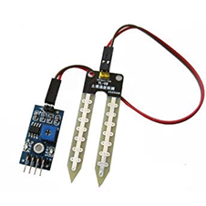
1. Soil Moisture Sensor
The soil moisture sensor is installed in the ground and it keeps the check of its value.
The moisture level is predefined on the arduino program and it starts sensing the value of moisture. As the value of moisture decreases i.e. low water level content, the water pump will be triggered and water will start to flow from the water resource.
The water will keep on flowing until the moisture level reaches the desired value. The value of moisture can be changed based on what the farmer is growing. Lets say the farmer is growing rice. Rice requires flood irrigation and constant water in its ground area.
For this purpose the moisture level sensor should be set to the maximum so that flood irrigation can be achieved. Rice can be grown in cool environment and high moisture level and the conditions can be met easily with this project.

Slide 15
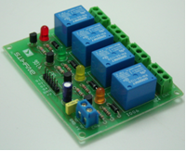
2. Relay
Relay is used to control the A.C. motors from the controlled DC signal. It can isolate one operated electrical circuit to another.
The principle behind the electromagnet operates the close and open circuit. Relay is applied wide area electronic circuits such as industrial control circuit, high power amplifier, telephone exchange, etc.

Slide 16
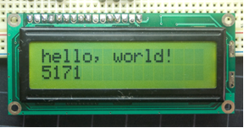
3. LCD pinout
It has 16 pins and the first one from the left to right is the Ground pin. The second pin is the VCC which we connect the 5 V pin on the Arduino board.
Next is the V0 pin on which we can attach a potentiometer for controlling the contrast of the display.

Slide 17
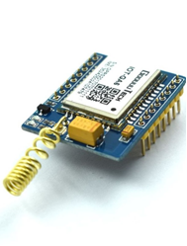
4. GSM module
The IEEE standard of GSM is 802.11 and its stands for Global System for Mobile communication. It is digital transmitting and receiving technology used in cellular mobiles for open air.
In this project we have used a GSM module to communicate between farmer and system for long range inspection. GSM is supported in basic mobile handset.
It consists of an antenna which will transmit and receive messages from GSM mobile phone.

Slide 18
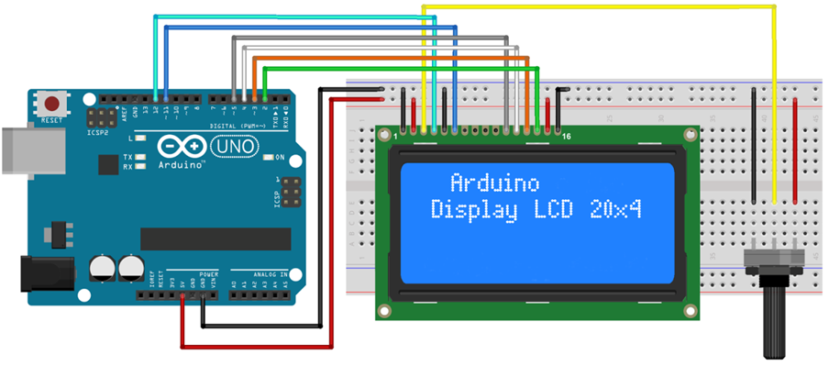
Circuit Diagram Of The Project

Slide 19
Working
The automatic irrigation system was designed to continuously sense the moisture level of the soil.
The system responds appropriately by watering the soil with the exact amount of water required and then shuts down the water supply when the required amount of soil moisture is achieved.
The reference amount of soil moisture is already fed to the microcontroller beforehand. This reference soil moisture content was made to be adjustable for the three most common soil types (sandy, loamy and clayey soils).
The moisture sensors and temperature sensors were designed using probes made from corrosion resistant material which can be stuck into soil sample.
Voltage levels corresponding to the wet and dry status of the soil sample were computed by measuring the resistance between the moisture probes and matching them to output voltage of a comparator circuit.
Also the data is received from the sensor along with the state of the motor is notified to the client via SMS and it is done with the use of a GSM module..

Slide 20
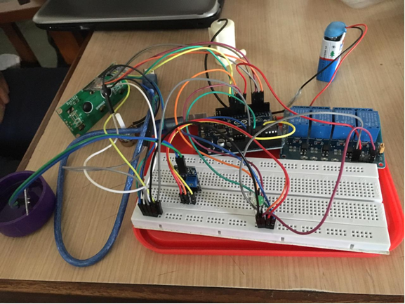
Overall Concept Of Our Project

Slide 21
DRAWBACK AND FUTURE WORK OF MODEL.
Drawbacks:
This system requires continuous GSM connectivity as the live data can be recorded on the system
As the area of irrigation increases, more number of sensors are needed that increases the total cost of system.
The security of the agriculture is not ensured against the attacks of stray animals.
The sprinkler system is the most expensive mode of watering.

Slide 22
Future work for this model
Alarm System can be used to alert the Farmer/Land Owner in case of any Unusual activities on the field: this can be obtained by having sensors around to monitor the Field of by installing a live surveillance which can detect unusual movement by image processing.
Installation of a solar panel for providing electricity instead of a Pump: As solar energy is a renewable source and is in abundance, this can be used to save energy.
Providing Different types of Irrigation according to crops: Not limiting ourselves to one type of watering method but using Drip irrigation, sprinklers etc as different crops need different type of watering system.
Taking weather into account: To be able to control the irrigation according to the weather such that we can predict when to water the crops and when not to according to when the next rainfall would be, this prevents over flooding.

Slide 23
RESULT
Our system consists of two sensors namely, soil moisture sensor and the temperature sensor. The soil moisture sensor’s value varies according to the moisture level on the field. The temperature sensor records the temperature of the surroundings.
The design made such that if the moisture sensor senses moisture less than the set threshold value then the plant is watered. The GSM module is interfaced with the Arduino to establish cellular communication between the system and the user. Live data is sent through the GSM module to the user via text message after insertion of the sim card into the GSM module.

Slide 24
This was an essential part of our study as we compared the collected data and the previous data to obtain the desired threshold values for temperature and moisture such that any overflow or underflow doesn’t occur.
With this comparison we also could figure out how much millilitres water we saved on a monthly basis.

Slide 25
CONCLUSION
The irrigation system on automation uses optimal resources to improve the efficiency of the irrigation. This system can be implemented in places that face water shortage to improve agricultural sustainability.
In this project a prototype includes sensing element node and data storage. The sensing element node is deployed on the field for sensing the soil parameters such as temperature, moisture, luminosity and humidity.
According to the soil parameters the automation is achieved by turning the motor on and off using the threshold values embedded in the code.

Slide 26
Thank You

